Slide 1
Chapter 5:
Antennas

Slide 2
antennas
An antenna is an electrical conductorموصل or system of conductors
  Transmission - radiates يشعelectromagnetic energy into space
  Reception - collects electromagnetic energy from space
In two-way communication, the same antenna can be used for transmission and reception
For reception of a signal, electromagnetic energy impingingتؤثر on the antenna is converted into radio- frequency electrical energy and fed into the receiver.
An antenna will radiate power in all directions but, typically, does not perform equally well in all directions.

Slide 3
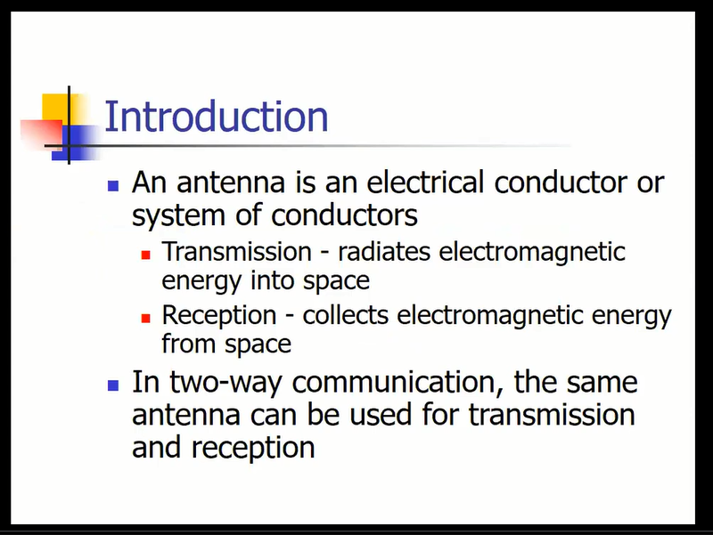

Slide 4
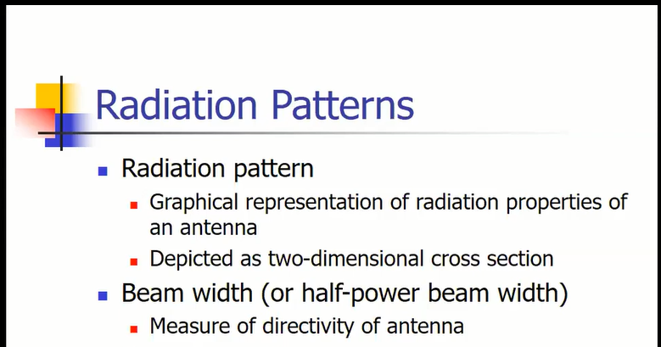
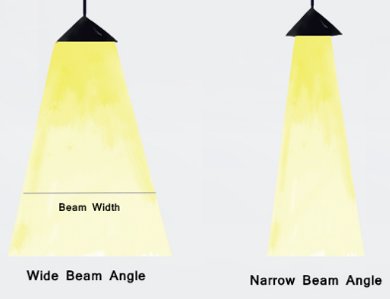
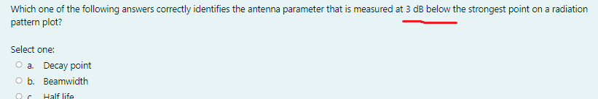

Slide 5
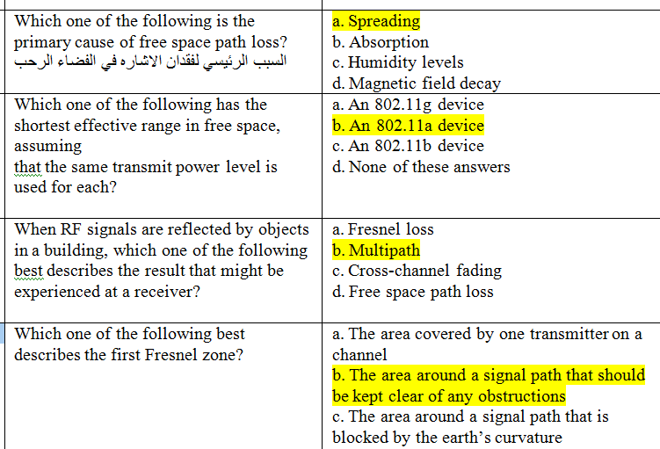

Slide 6
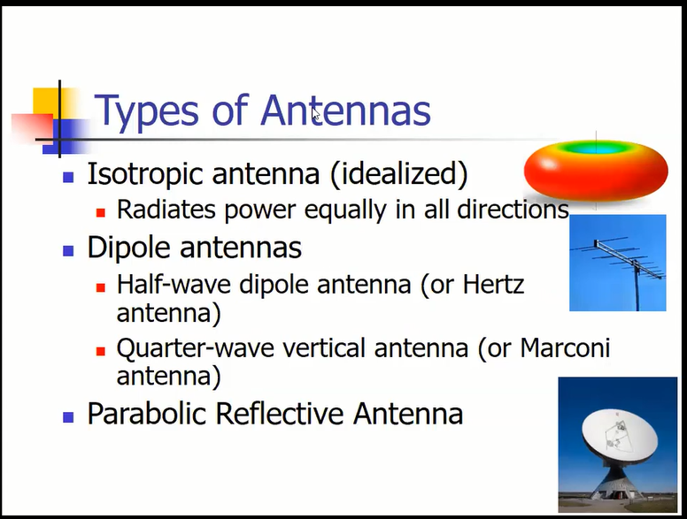

Slide 7
Antenna Radiation Patterns

Slide 8
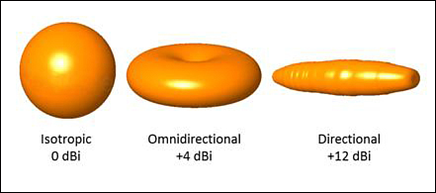
Figure 4-4 shows some simple examples, along with some example gain values. As you work through this chapter and examine antennas on your own, notice how the gain is lower for omnidirectional antennas, which are made to cover a widespread area, and higher for directional antennas, which are built to cover more focused areas.
Tip The gain itself is typically not indicated on either E or H plane radiation pattern plots.
The only way to find an antenna’s gain is to look at the manufacturer’s specifications.
Figure 4-4 Radiation Patterns for the Three Basic Antenna Types

Slide 9
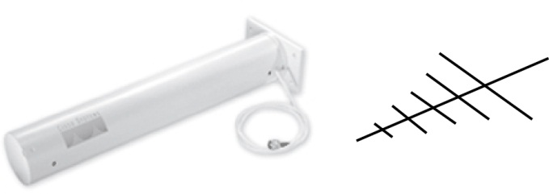
Figure 4-17 Cisco Yagi Antenna

Slide 10
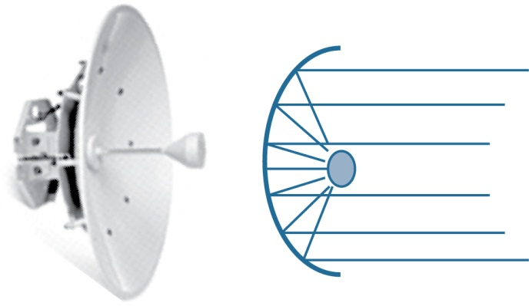
Figure 4-20 Cisco Parabolic Dish Antenna

Slide 11
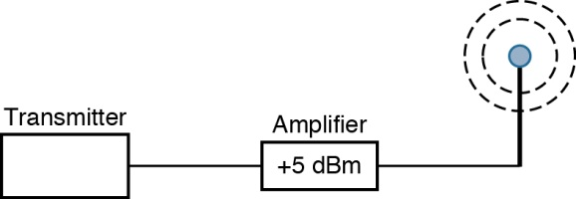
Amplifier:مضخم اشاره
Figure 4-23 Using an Amplifier to Add 5-dBm Gain

Slide 12
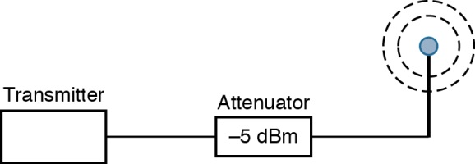
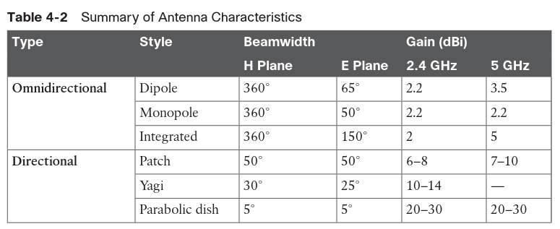
attenuator:تخفيف قوة الاشاره
Figure 4-24 Using an Attenuator to Add 5-dBm Loss

Slide 13
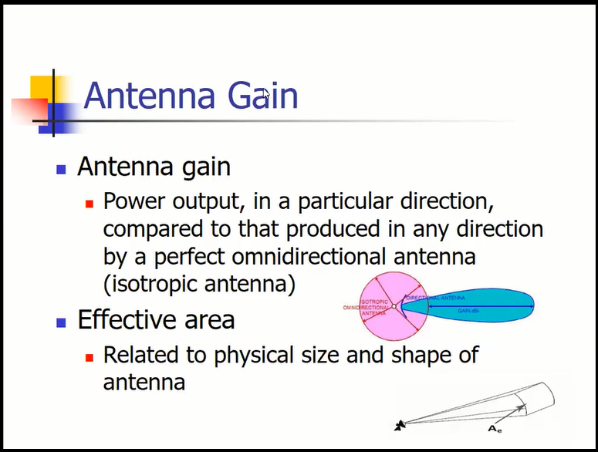
هوائي شامل الاتجاهات

Slide 14
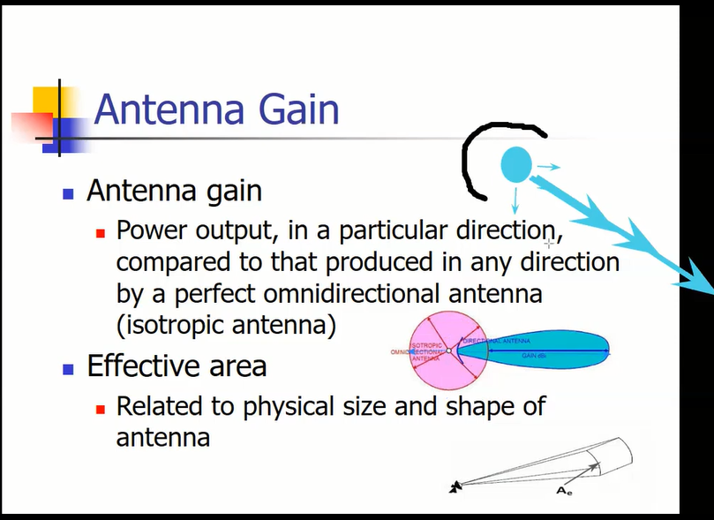

Slide 15
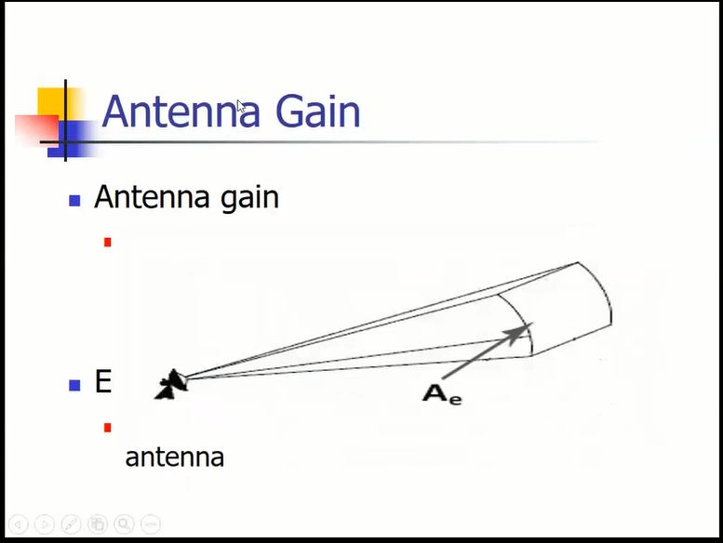

Slide 16
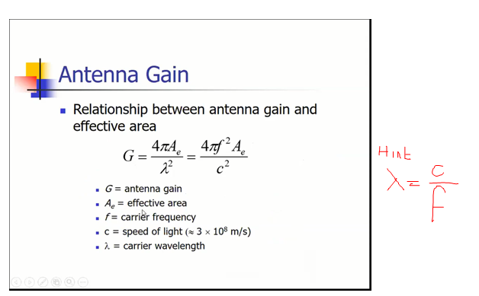

Slide 17
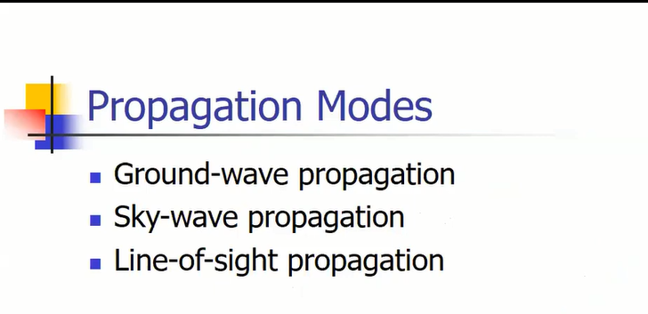

Slide 18
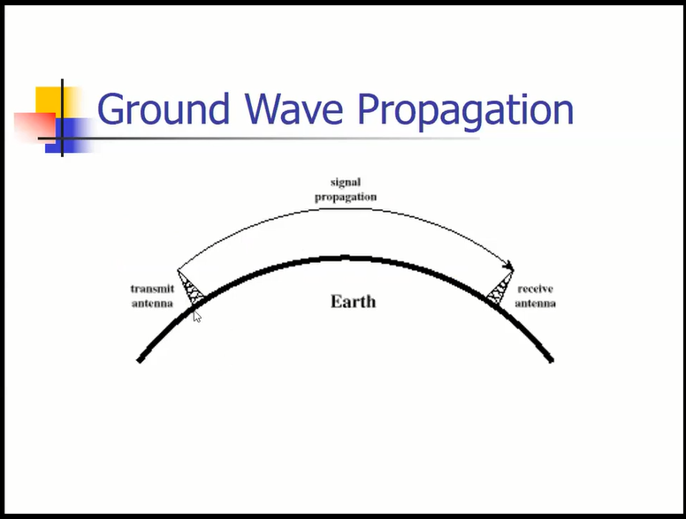

Slide 19
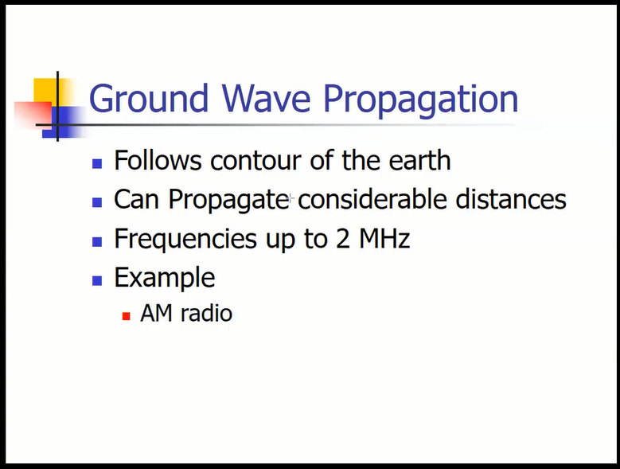

Slide 20
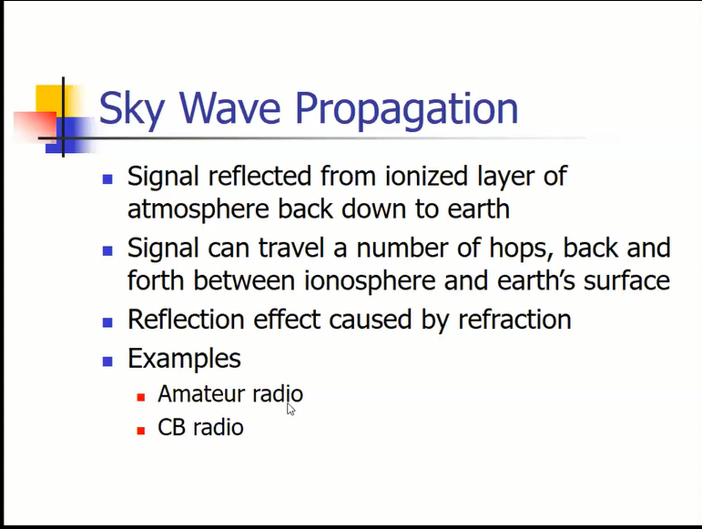

Slide 21
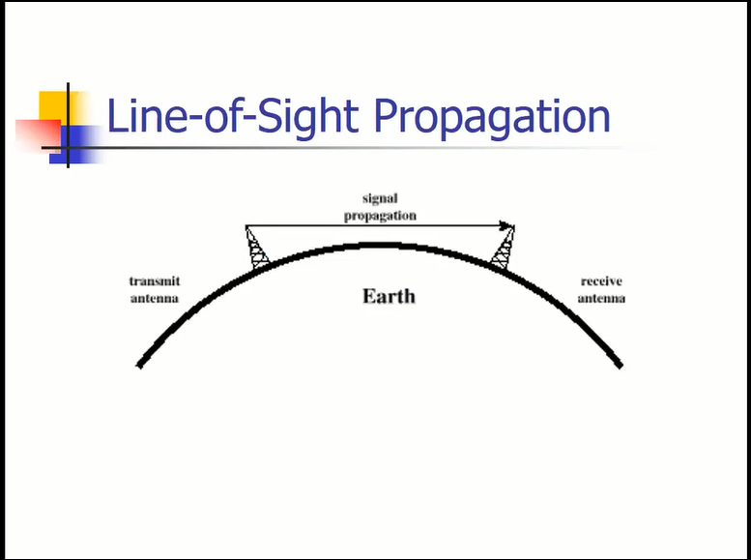

Slide 22
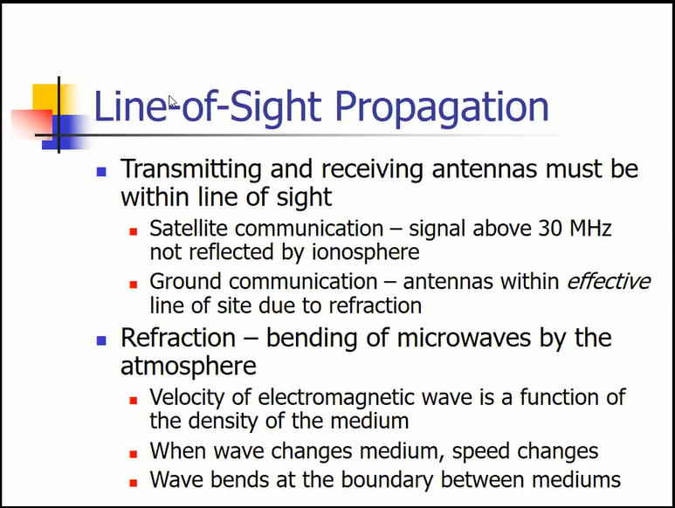

Slide 23
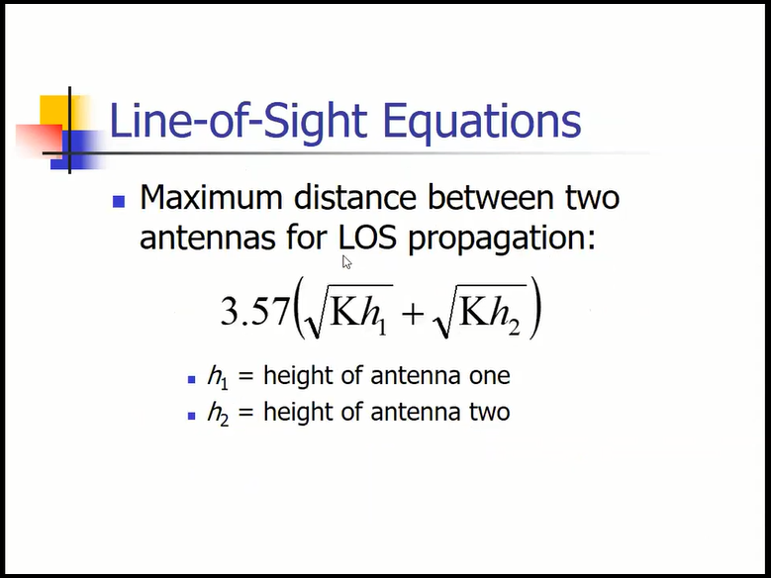

Slide 24
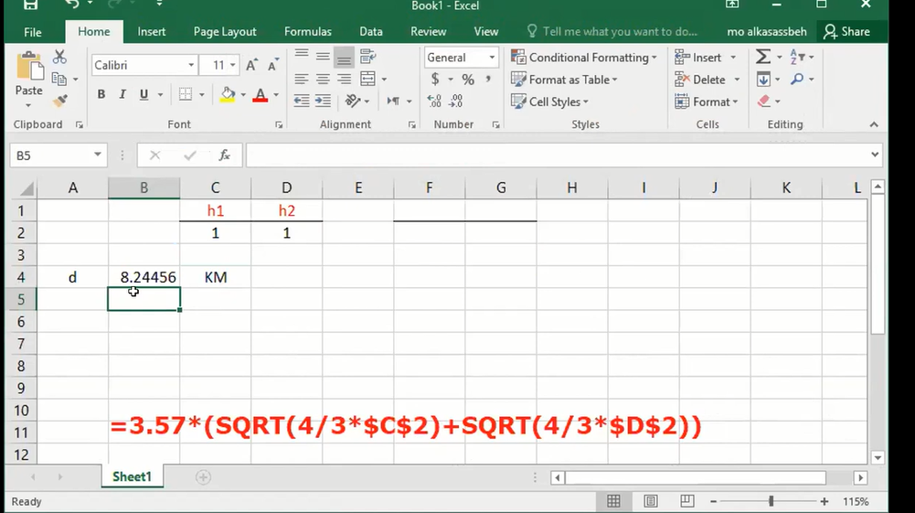

Slide 25
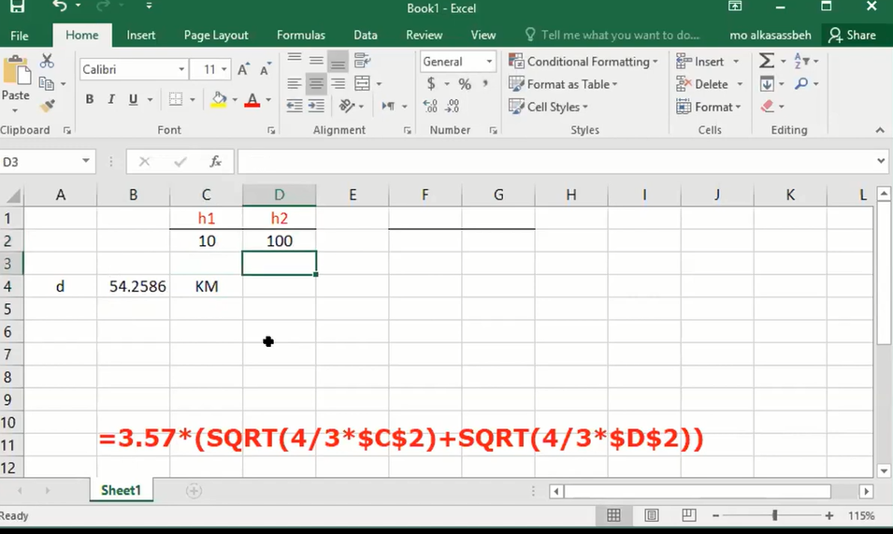
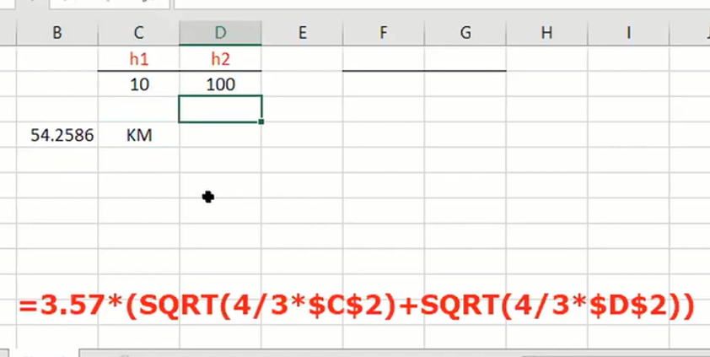

Slide 26
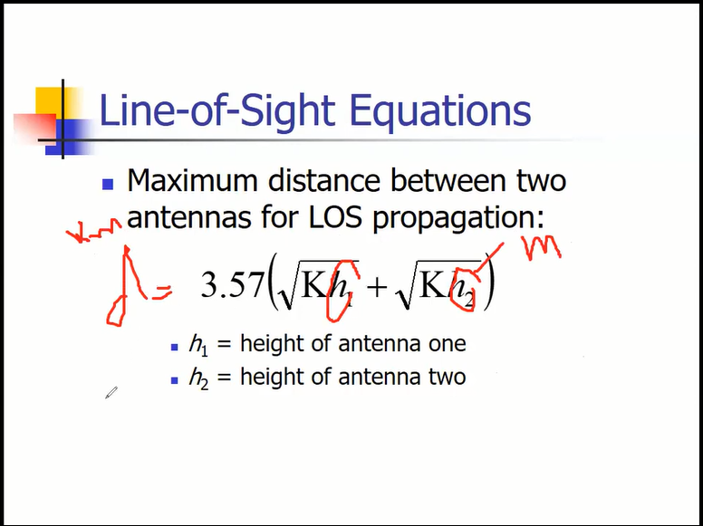

Slide 27
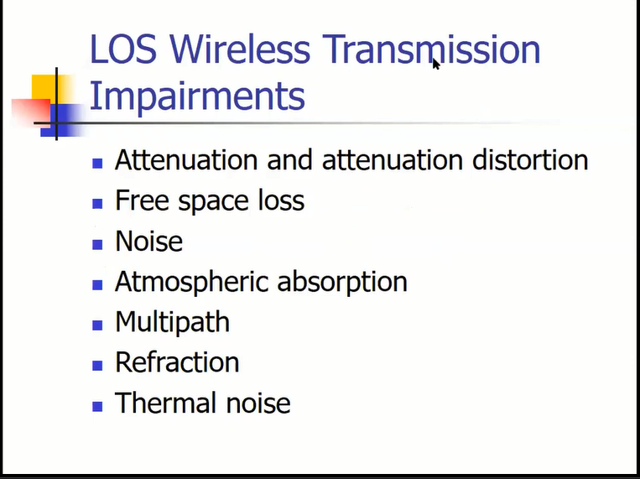

Slide 28
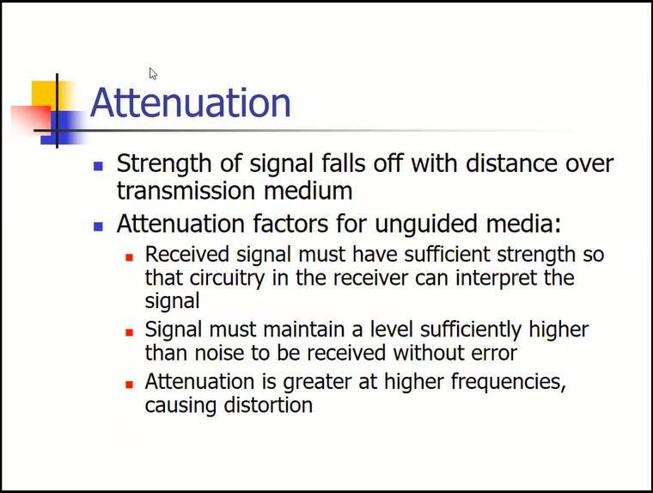

Slide 29
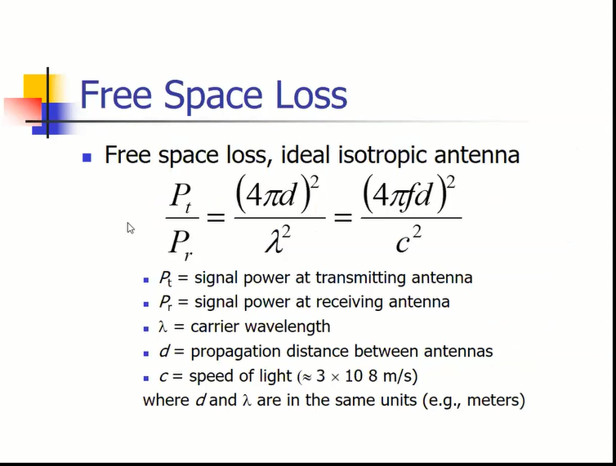

Slide 30
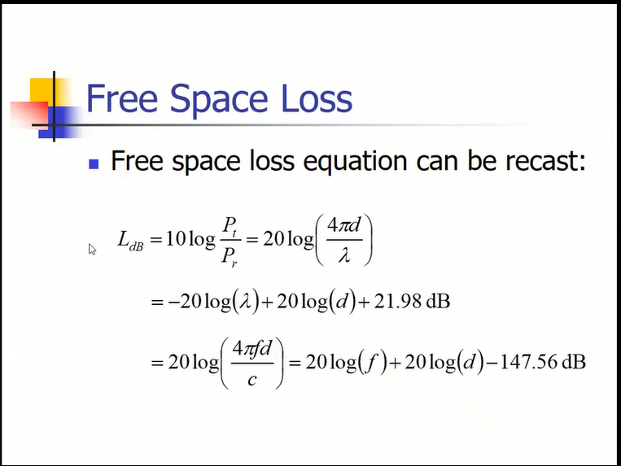


Slide 31


Slide 32
